Slide 1

Portland Public Schools 403(b) Plan
PPS/CCC* 403(b) PLAN Website: WWW.NCOMPLIANCE.COM
October 7, 2024 / Jim kelleher
*CCC helps PPS administer the 403(b) program -- Call CCC at 503-968-8961 with any questions

Slide 2
Who can contribute to a 403(b) Plan?

Slide 3

403(b) Audience
Who is Eligible?
  Typically, any staff member with W-2 pay.
What is a 403(b) Plan?
  School district 403(b) Plans are voluntary supplemental retirement savings plans.
  Designed to supplement retirement benefits available from State pension plans and Social Security.
What Contributions Types Are Offered?
  Pre-tax 403(b)
  Roth 403(b)
Notes:
Sometimes student workers or employees that work less than 20 hours per week may be excluded

Slide 4
Who can help me with my 403(b) plan?

Slide 5
403(b) Plan Support
Employees & Retirees
Employer:
Deduct $ & Plan Oversight
CCC:
Compliance, Approvals & Questions
Vendor:
Investments & Account Recordkeeper
Advisor: Optional Help
Team Effort

Slide 6
How does the 403(b) Plan work with my State plan?

Slide 7
Use the 403(b) to
Increase Retirement Savings
Personal Savings
Social Security
State Pension Plan
  403(b)* pre-tax or Roth
    457(b)* pre-tax or Roth
  IRA pre-tax or Roth
  Other Savings (after-tax only)
*Similar to a 401k.
Notes:
403 and 457 benefit from payroll deductions and higher limits than an IRA. All three are tax-advantaged which allow employees to save more for retirement than non-tax-advantaged account.

Slide 8
Pre-Tax vs Roth Basics

Slide 9
Pre-Tax Deferral vs. Roth
(Pay Taxes Later or Pay Now)
*Qualified Distribution required for tax-free investment gains:
(Reach age 59.5 and Roth 403(b) account has been opened for 5 years)

Slide 10
How does a 403(b) reduce taxes & increase savings?

Slide 11
Let’s start with Roth Contributions
ROTH (after tax)
Traditional (before tax)
Roth and Traditional

Slide 12
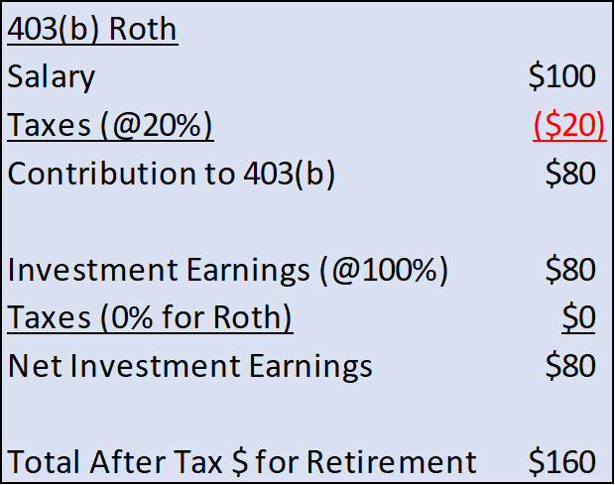



Roth 403(b)
Tax Benefits Illustration

Slide 13

Traditional 403(b)
Tax Benefits Illustration

Slide 14


403(b) Tax Benefits
Illustration

Slide 15
What are some of the key 403(b) plan rules?

Slide 16
403(b) Summary
IRS Annual Contribution Limits (2024) | $23,000, under age 50 $30,500, age 50 or older
Special 15 Years of Service Catch-up Limit | Up to $3,000 per year ($15,000 lifetime max)
Pre-tax Deferrals Roth After-tax Deferrals | Yes Yes
Investment Options | Mutual Funds and Annuities from 10+ Investment Product Providers
Distributions*: Based on Severance Based on Age Based on Hardship | Yes at 59 ½ Yes
Loans | Yes
Purchase Service Credit Transfers | Yes
*Early withdrawal penalty of 10% before age 59 ½ unless due to disability, death or separation of service after age 55.

Slide 17
Where do my 403(b) contributions get invested?

Slide 18
403(b) Vendor
Comparison
1. Typically, all products are subject to account administration fees and investment management expenses. Some annuity contracts may have surrender charges.

Slide 19
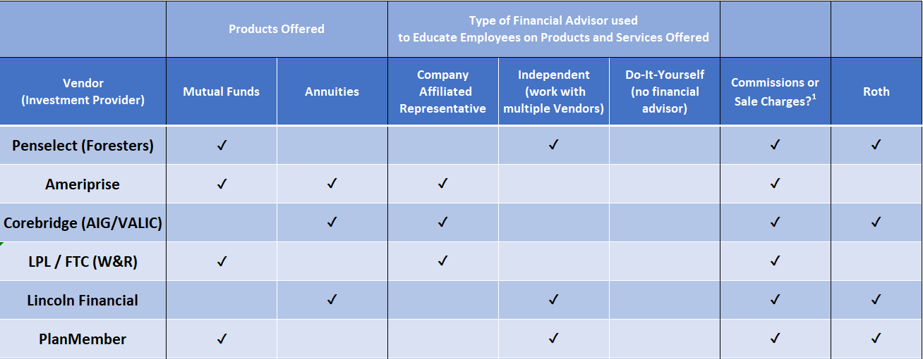
403(b) Vendor
Comparison (2)
1. Typically, all products are subject to account administration fees and investment management expenses. Some annuity contracts may have surrender charges.

Slide 20
What happens to my 403(b) account when I leave the district?

Slide 21
403(b) Options upon changing jobs
Keep in the 403(b) plan at former employer
Rollover to 403(b) at new school district
Rollover to 401(k) at for-profit company
Rollover to a personal IRA
Take a cash distribution

Slide 22
How do I start contributing?

Slide 23
How to make
403(b) Contributions
Open an account with a plan Investment Provider.
Start your contributions through PeopleSoft Employee Self Service.
Visit CCC website for 403(b) Plan Information
  www.ncompliance.com
  Call CCC at 503-968-8961
  Submit a question at: https://www.ncompliance.com/ask-ccc.aspx

Slide 24
When do I work with CCC?

Slide 25
403(b) Life Cycle &
CCC Engagement
Start Now!
  Make time your friend
  Salary Reduction Agreement (via PeopleSoft)
Accumulation Phase
  Make changes to address retirement needs
  Make investment & vendor changes / In(de)crease contributions
‘Decumulation’
  Make spending decisions in retirement
  Distributions, rollovers, loans, PSCTs

Slide 26
Where can I find more information on the 403(b) Plan?

Slide 27
Tools & Info
(Links from CCC website)
BrokerCheck
Oregon’s Insurance Resource Page – Check a License
PPS Vendor information & links including Fee Summary
403(b) General Information
Choosing an Investment
CCC 403(b) Education Videos
403b Compare (for CA districts but useful information)

Slide 28
Start contributing today!

Slide 29
“Compound interest is the eighth wonder of the world.”
                ~ Attributed to Albert Einstein

Slide 30
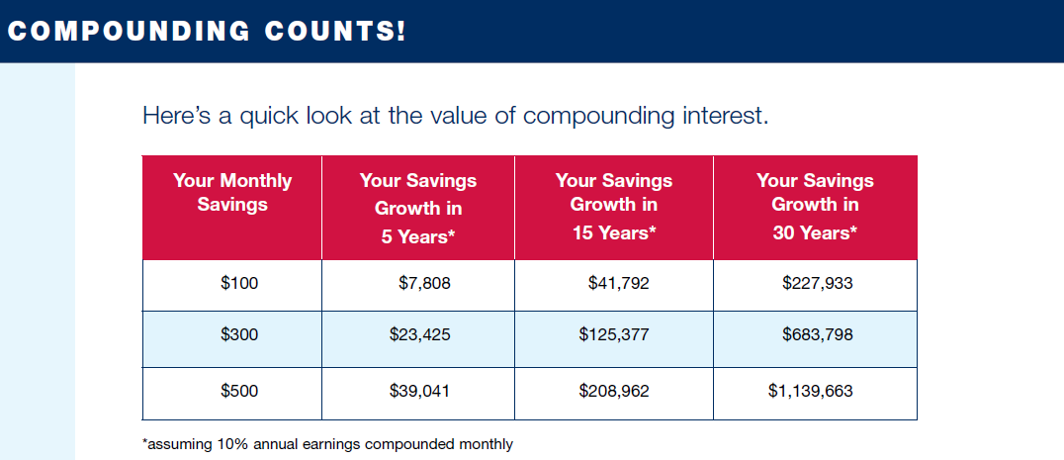

Slide 31
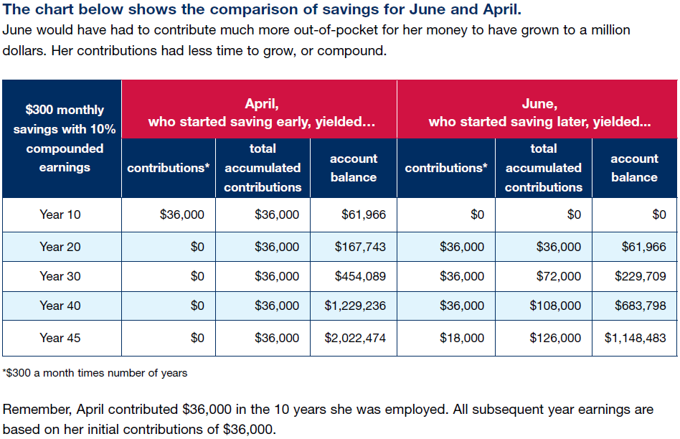

Slide 32
What are some additional Roth considerations?

Slide 33
Roth Benefits &
Considerations

